Slide 1
SDB Predicting Energy Usage at 88acres
Mike Wise
Version 0.7
19 Aug 2015

Slide 2
SDB Business Goals
Energy Usage Prediction
Planning and Hedging Energy Purchasing Strategies
Predicting and Mitigating Peak Energy usage to reduce Demand Charges
Predictive Maintenance
Recalibrating fault importance
Measuring impact of equipment performance on Energy and Indoor Climate
Predicting equipment outages

Slide 3
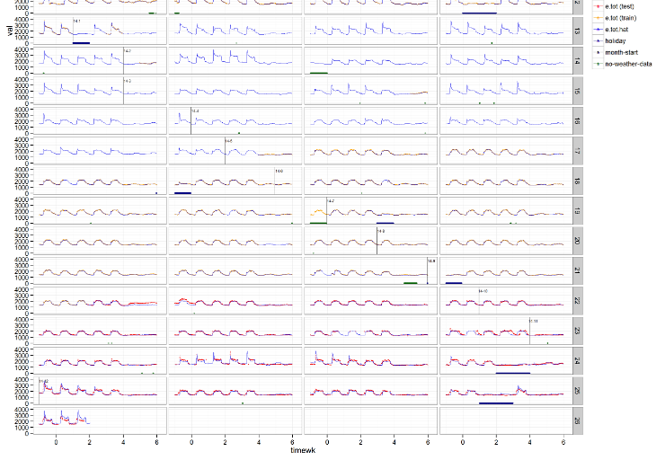
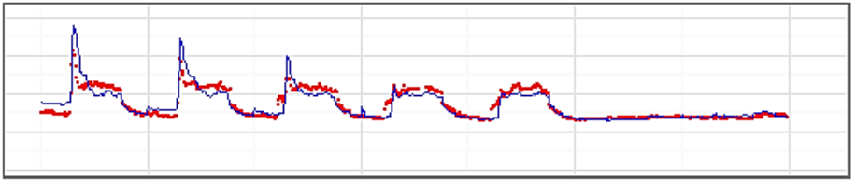
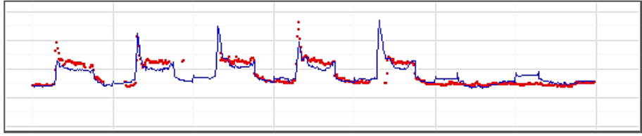
Typical Building Usage Profile

Slide 4
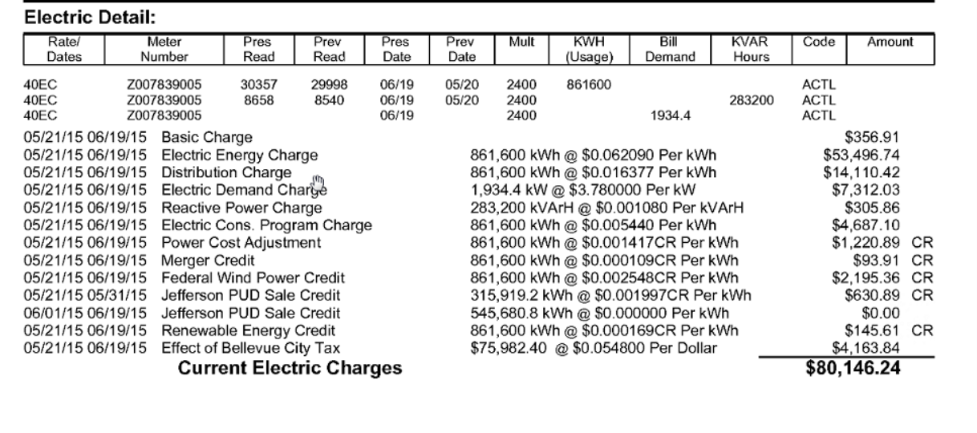
Typical Electric Bill with Usage/Demand Charges
Usage
Demand

Slide 5
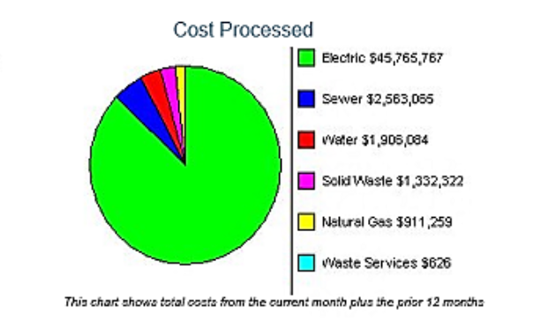
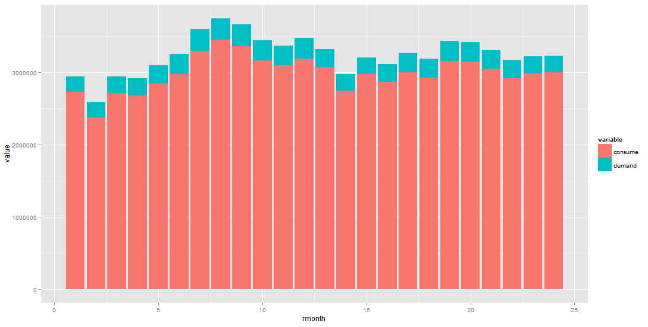
Yearly Financial Impact

Slide 6
Project Resources
1 TB of data – HVAC, Energy Usage, and some temperature data
Azure Account
SQL VM
Hadoop cluster
AML Workspace
1 full-time MCS Architect/DS Resource (Mike)
1 part-time (1.5 d/w) AML PG DS Resource (Girish)

Slide 7
Compute Landscape

Slide 8
SDB – The Data Science
CRISP-DM – best developed DS methodology
Little competition
6 Phases
Business Understanding
Data Understanding
Data Preparation
Data Modelling
Evaluation
Deployment

Slide 9
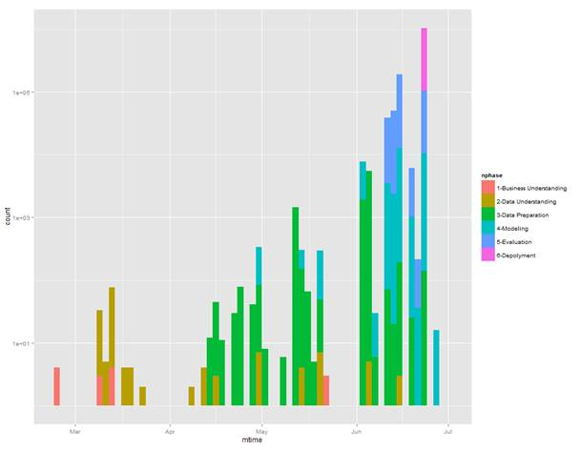
Time Line
4-5 months on project so far
Main project directory has 6000+ files in 62 folders

Slide 10
SDB Business Understanding - Overview
Actual Business Benefits articulated
Revisited at least twice during project
Initial focus was Pred.Maint. oriented, shifted to an Energy Focus
Energy Consumption underlies and prioritizes most other costs
Energy requires less data to understand (3-4 data streams per building)
Desire for quick-wins shifted focus again, to creation of a “demo”

Slide 11
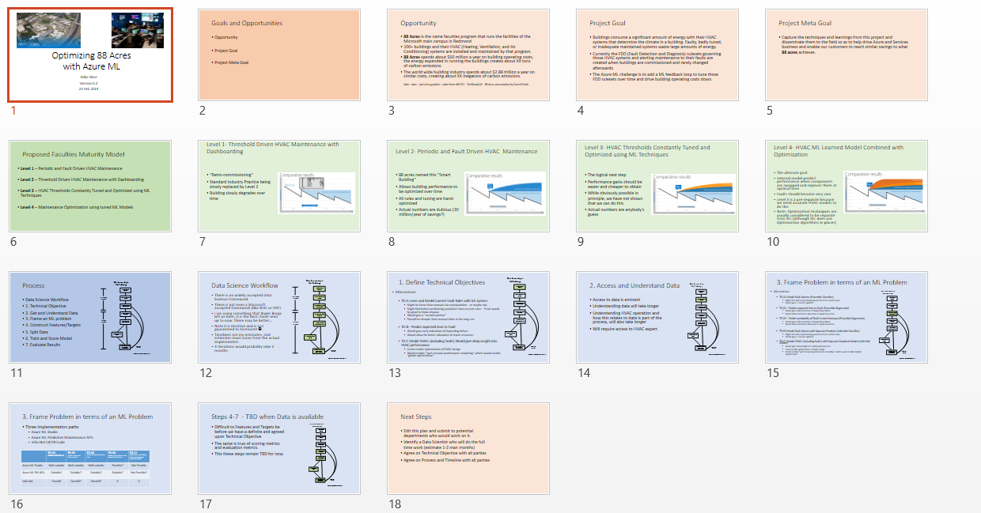
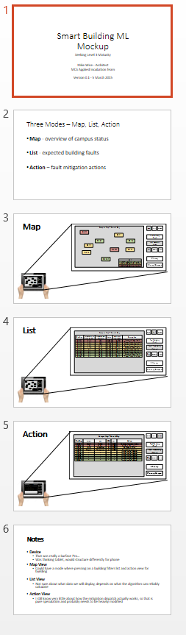
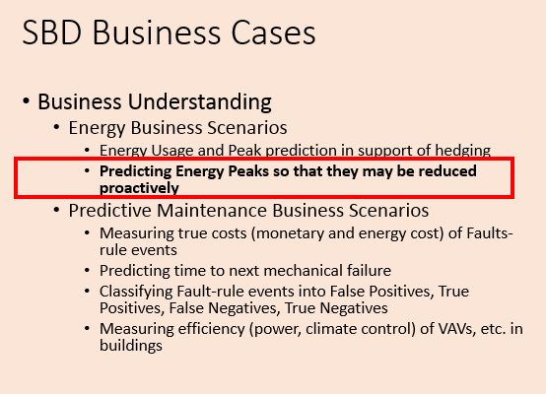
SBD Business Understanding
23 Feb 2015
5 March 2015
3 April 2015

Slide 12
SDB Data Understanding - Overview
Acquisition of data took time
Used R, Python, and sometimes Excel (not on Azure)
Delivered 1.5 TB of data in 9 SQL DBs
Approximately 500k (over 5000 per building or 14 per person!) data streams in 92 Puget Sound buildings
But only needed about 10-20 per building for first part of energy analysis phase
Data range was from 1 Jan 2013 to 31 Dec 2014

Slide 13
SDB - Data Understanding - Data Flow

Slide 14
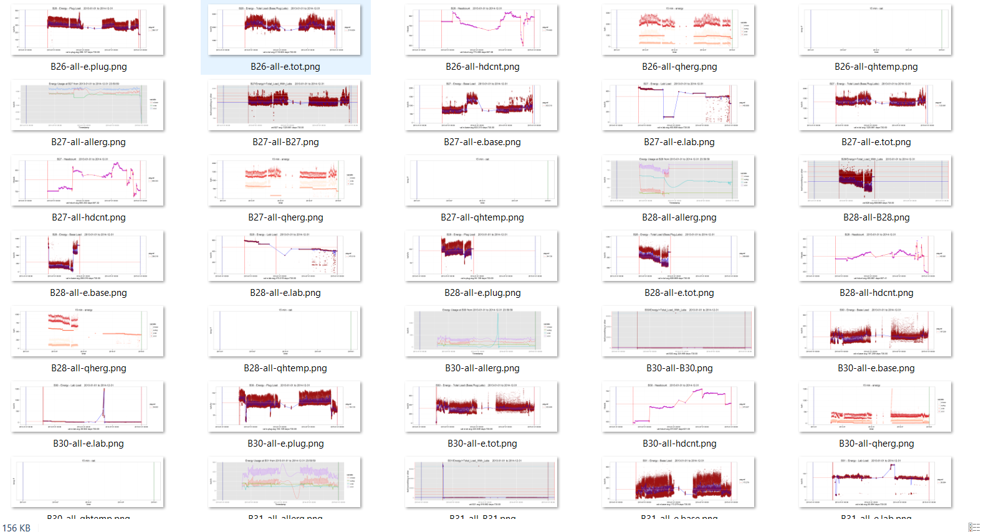
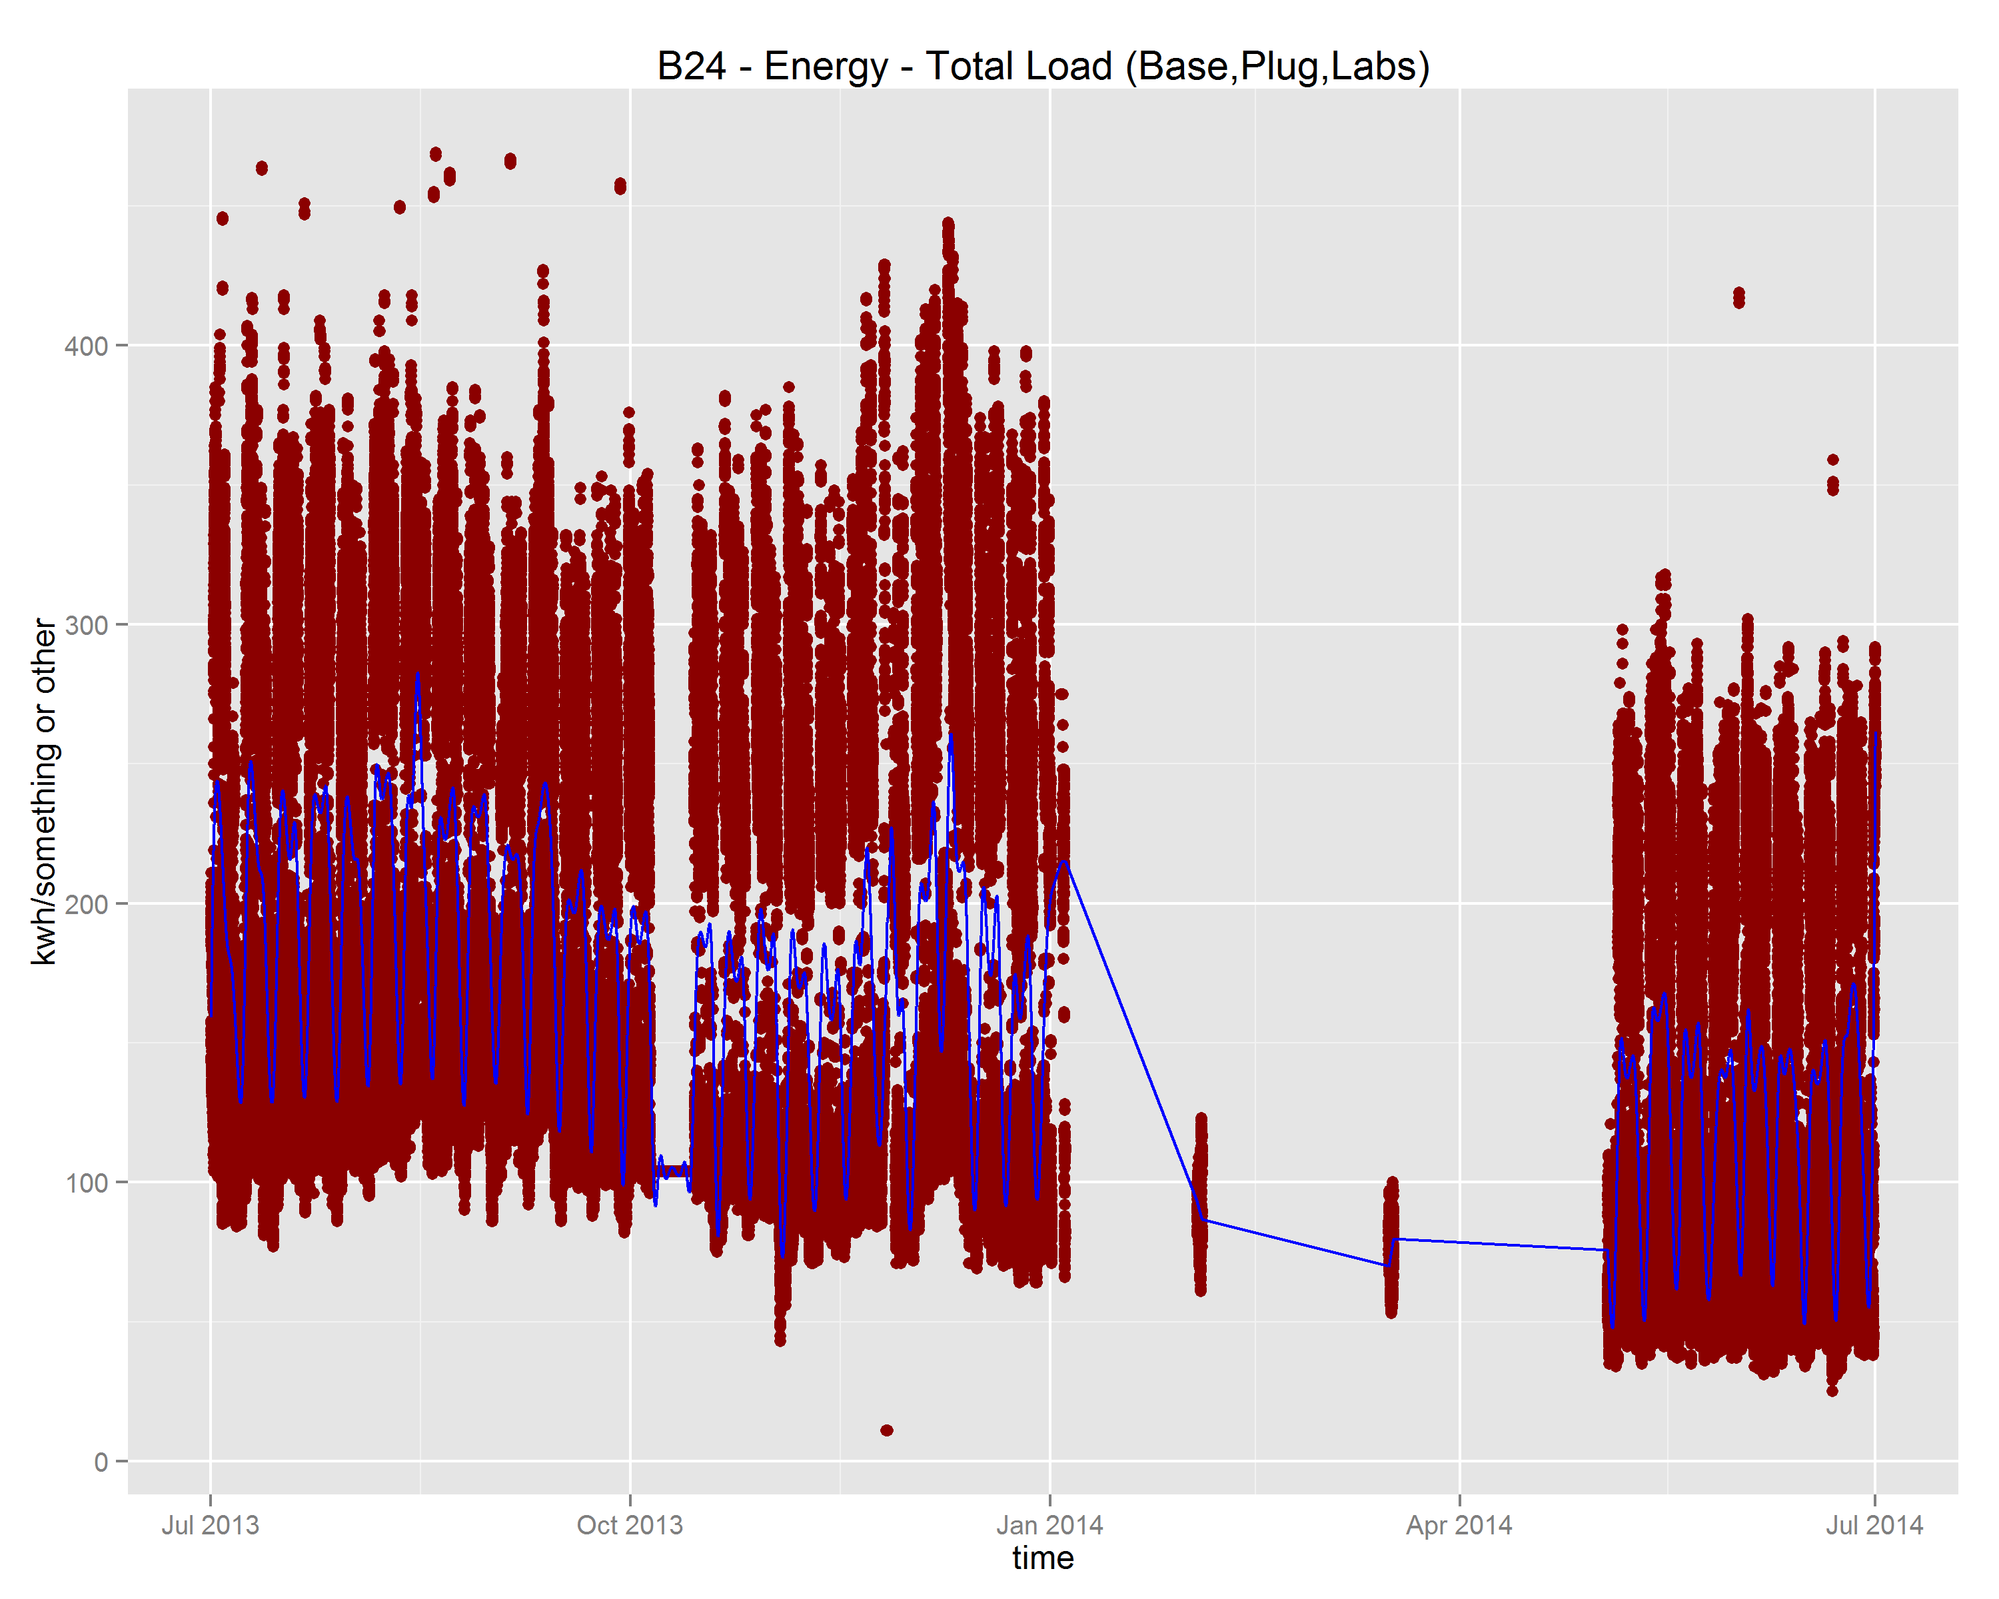
SDB Data Understanding – Building Data
Sampled at 1-10 minutes per stream depending on data type
All streams were missing data, up to 3 month gaps existed, most streams have between 20 and 80 percent coverage

Slide 15
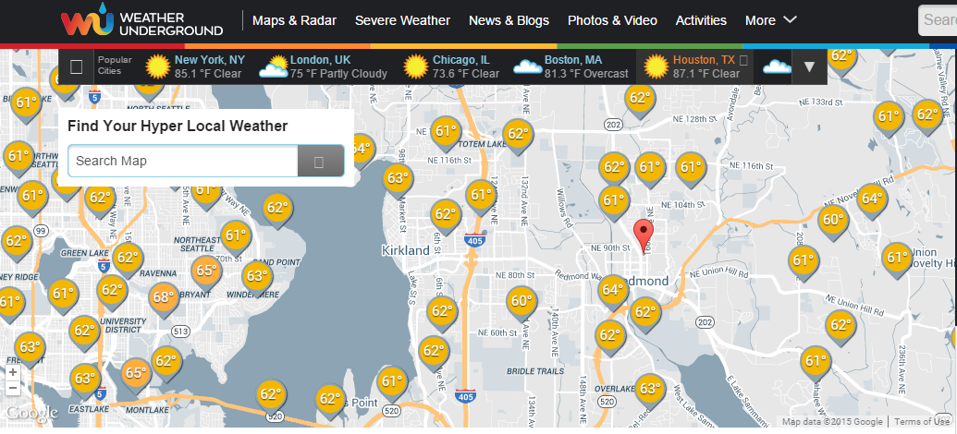
SDB Data Understanding – Weather Data
Weather Data from Weather Underground
10 values – including temperature, dewpoint, windspeed, humidity and some other – available as CSV
Not all stations have all data, or at all times
Took 4 weather stations in the Bellevue/Redmond/Kirkland area with continuous data back to 2009
Weather Data Gaps moved in the 1-2 percent range

Slide 16
SBD – Data Understanding Challenges
Large amount of data – 9 SQL DB between 320 and 160 GB
Unified over SQL view but was slow (could not build index over data)
Merging to one DB ran afoul of slow SQL Server, decided to switch to Hive
Exported to Hive – SIS output UCS-16
Noticed too late, made Hive twice as slow
Had to redo as UCS-8: 1.7 TB => 0.88 TB

Slide 17
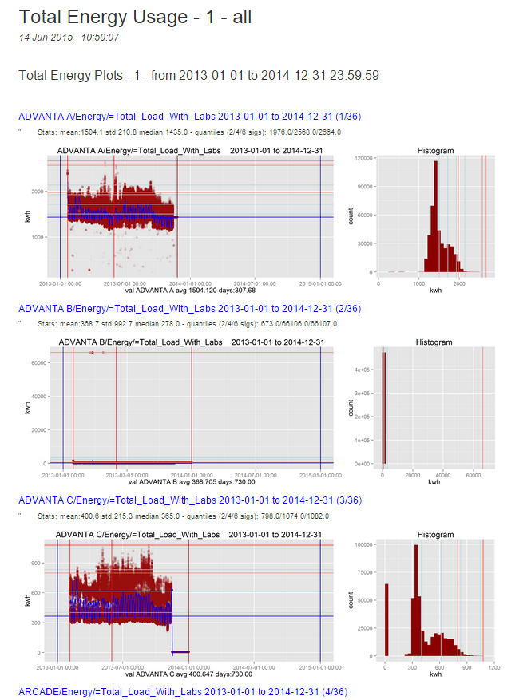
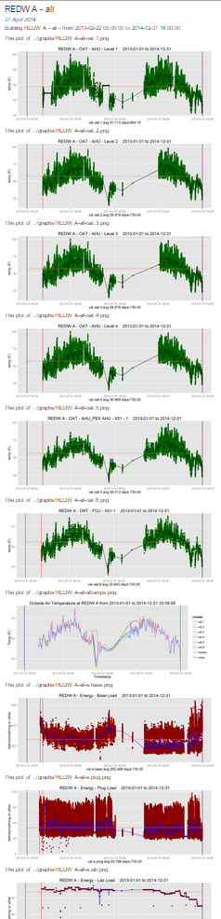
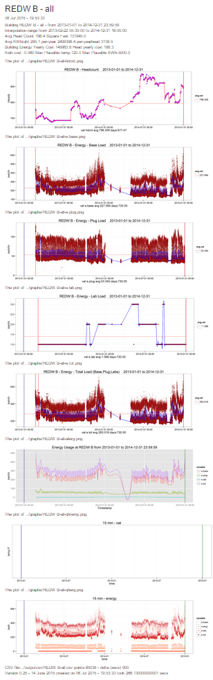
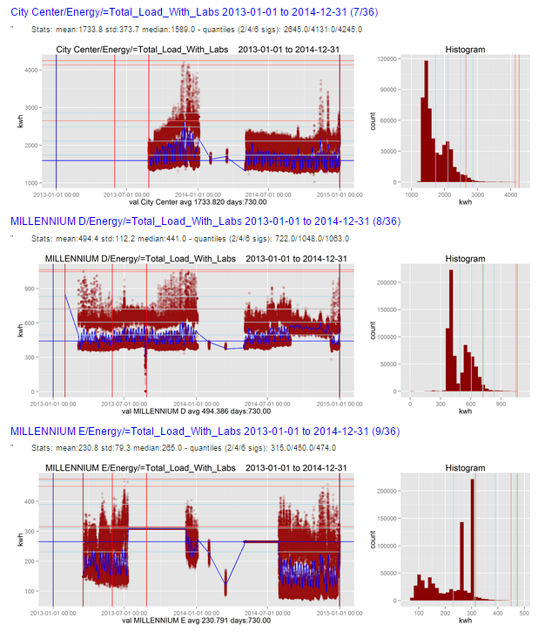
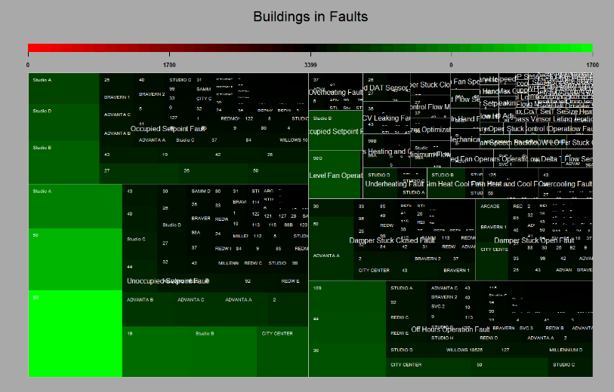
SDB - Data Understanding - Reports

Slide 18
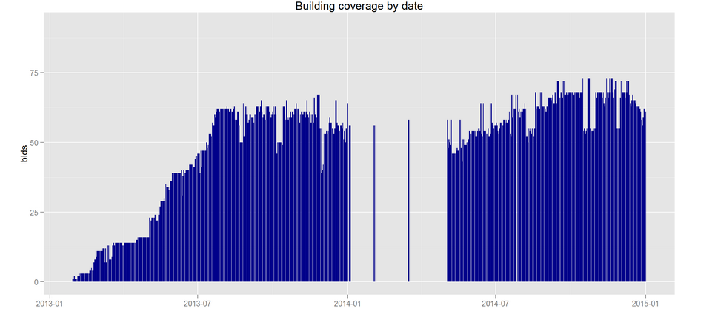
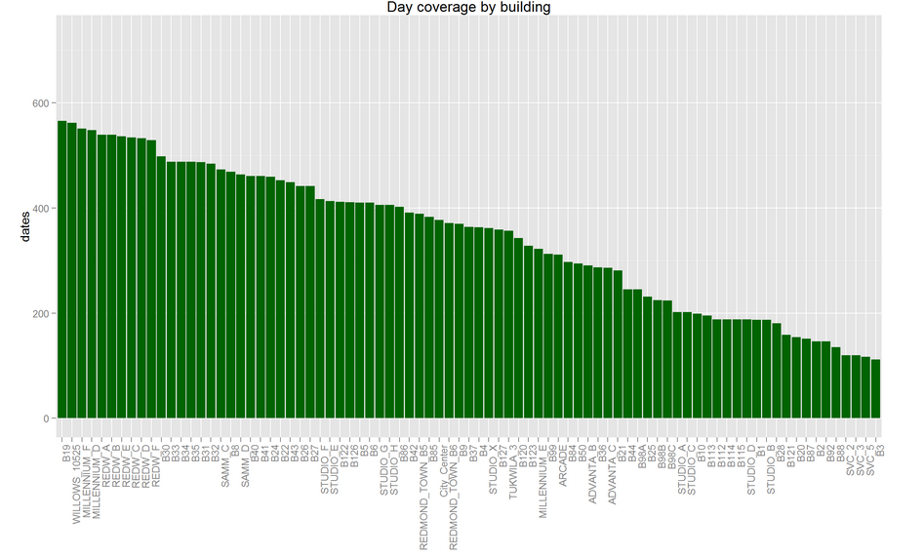
SDB - Data Understanding - Results

Slide 19
SDB – Data Preparation - Overview
Weather data gathered and consolidated
Weather data in 3-5 minute intervals
Averaged and gathered into 15 minute chunks
Eliminated Nas Gaps covered by
averaging weather stations
Interpolating few remaining gaps
Building data gathered and consolidated
Energy data in variable
Averaged and gathered into 15 minute chunks
Created heating degrees and cooling degree variables
Added time data
Marker for holidays
Conversion of time into decimal time for easier mathematical manipulation
End result is data for AML

Slide 20
SDB – Data Preparation – Data flow

Slide 21
SDB – Data Preparation – Challenges
Data Understanding increased enormously, many surprises
Spline fitting turned out not to work so well, abandoned
Hard to find weather stations with complete coverage
Looking for at least 6 years of coverage, 10 would be better

Slide 22
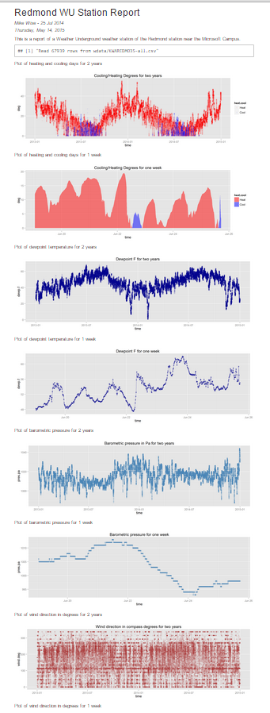
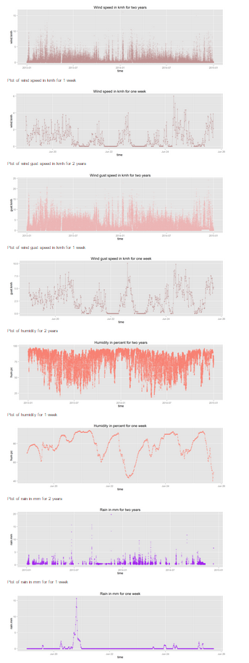
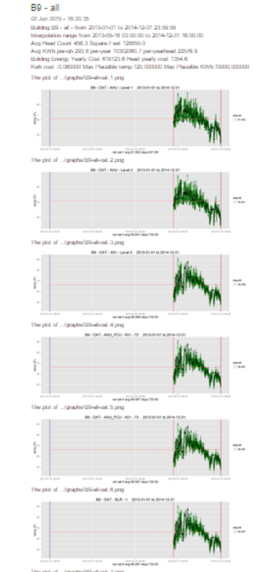
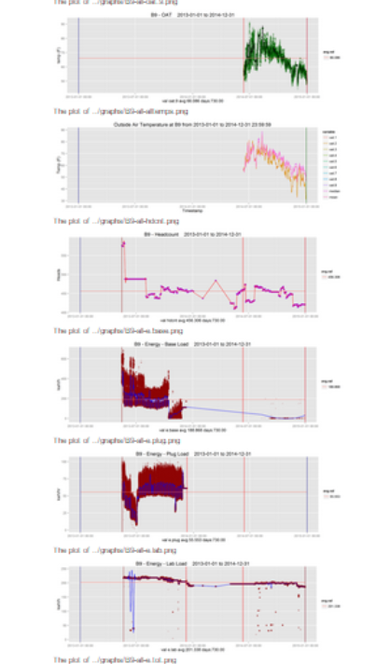
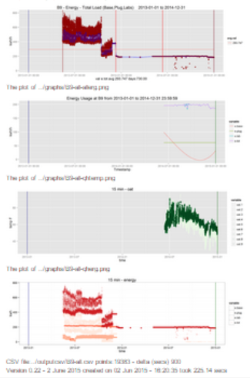
SDB – Data Preparation – Reports

Slide 23
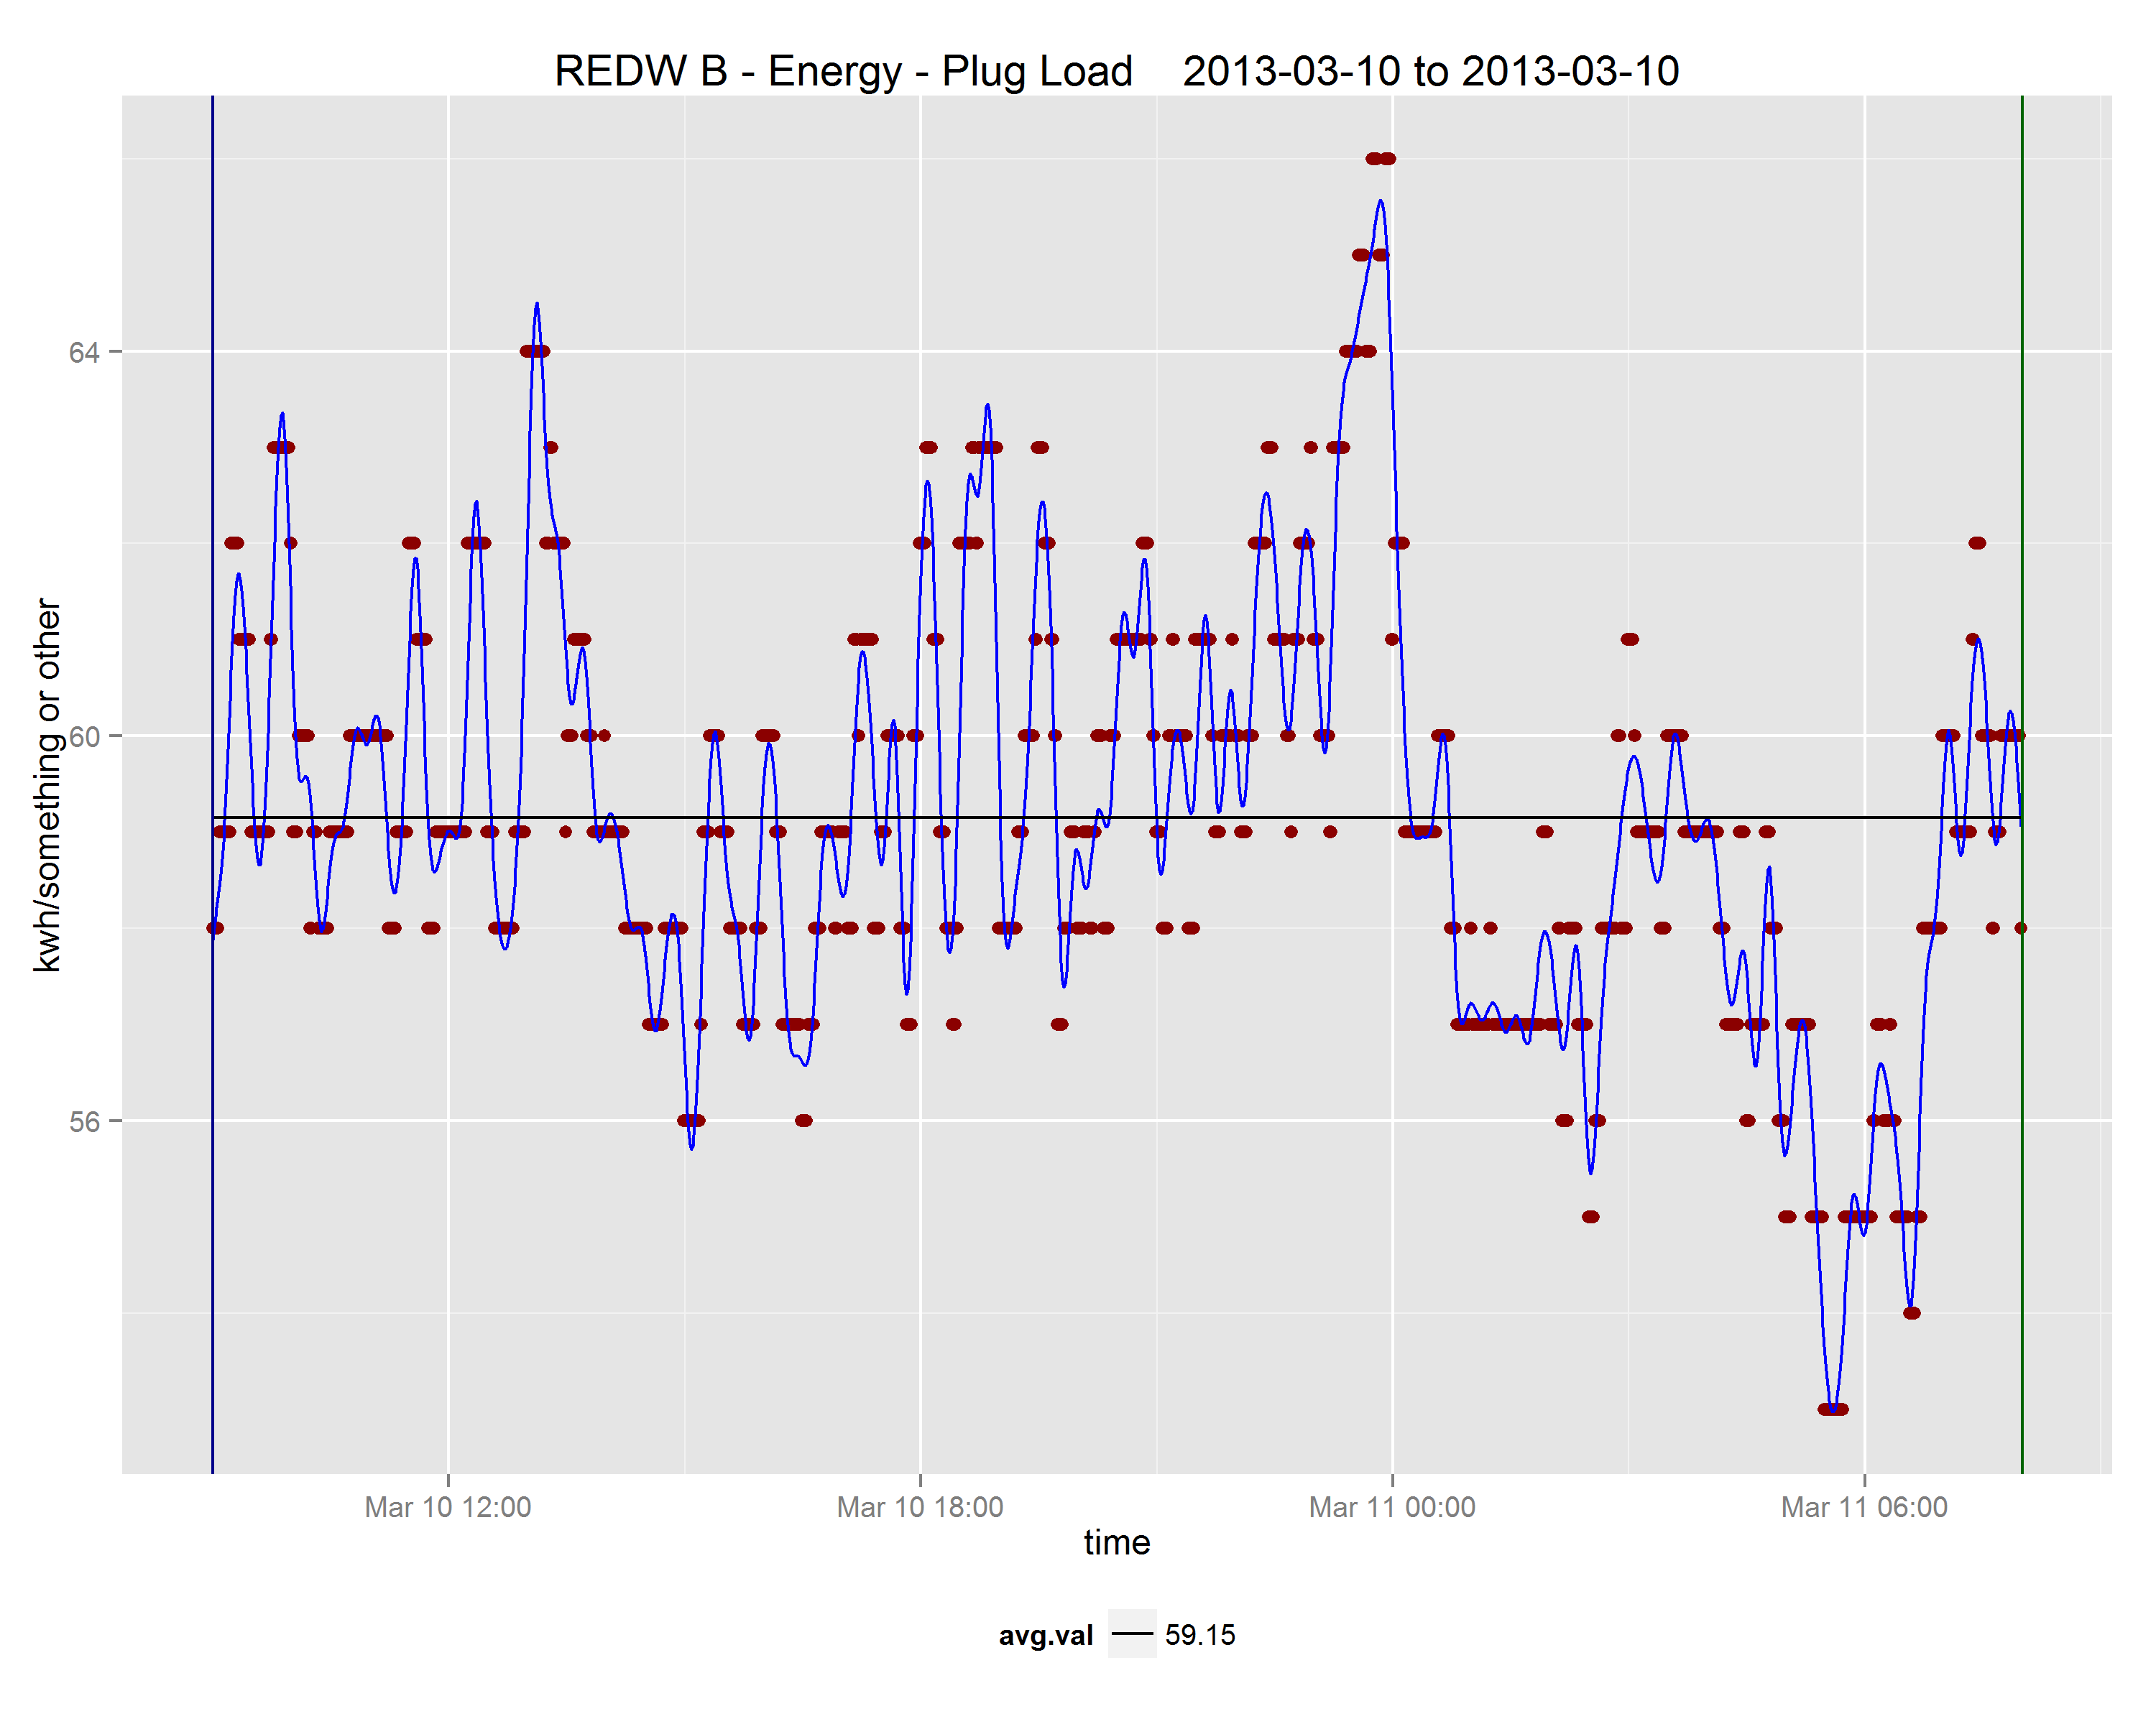
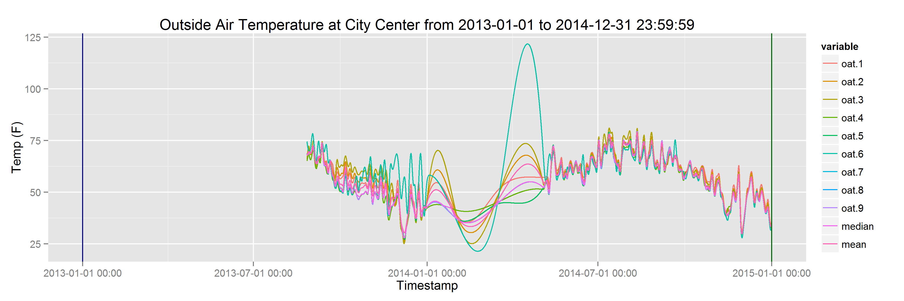
SDB – Data Preparation – Results

Slide 24
SDB Modeling - Overview
Considered different architectures
Went with Standard R and AML in the end
Many choices available today
Classic regression and optimization
Ensemble methods (Boosted Trees, Random Forests, etc.)
Other ML methods (NN, DNN, SVM, etc.)
Time Series forecasting (ARIMA)
Went with Ensemble methods as the are powerful, tolerant to missing data, and new and exciting ☺

Slide 25
SDB – Modeling - Architecture

Slide 26
SDB – Modeling - Challenges
92 buildings made modeling all buildings in AML practically impossible, only modeled about 20
No markup facilities in AML made reporting difficult
Wide variation in results over different buildings
Difficult to encompass results from 92 buildings

Slide 27
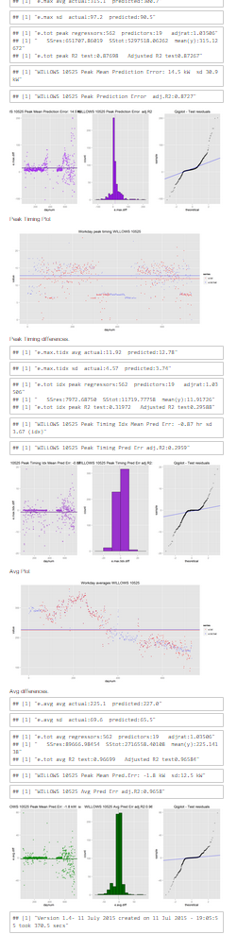
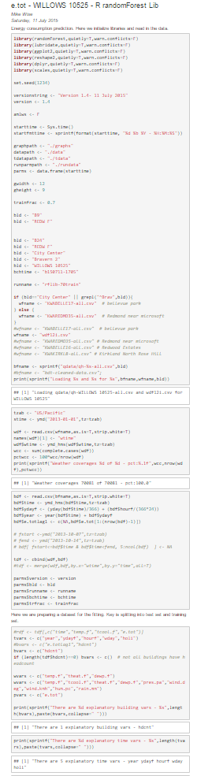
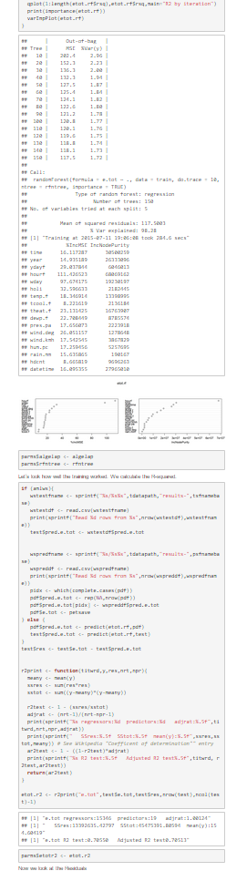
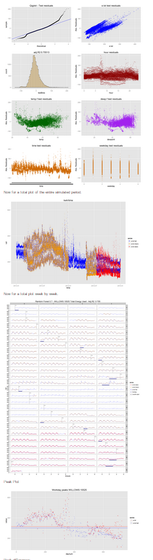
SDB – Modeling - Reports

Slide 28
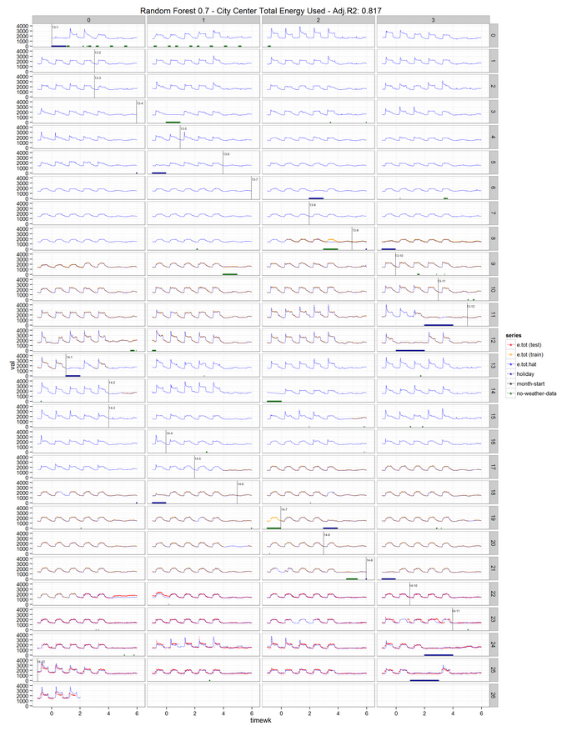
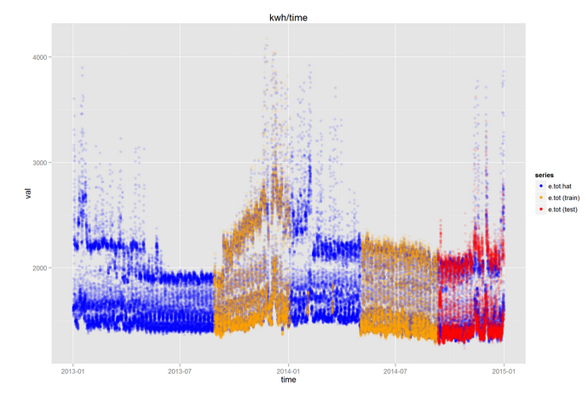
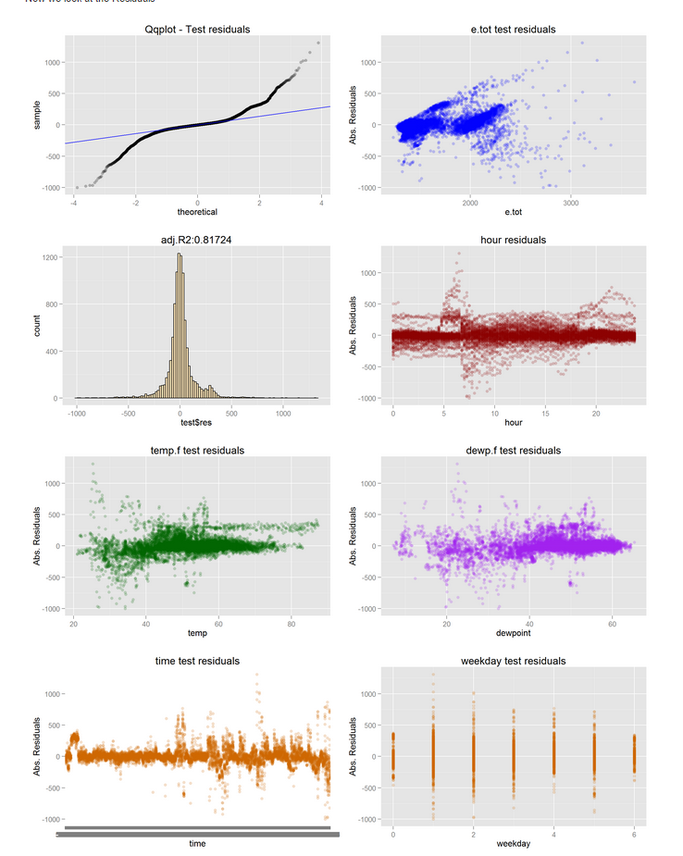
SDB – Modeling – Results (City Center)

Slide 29
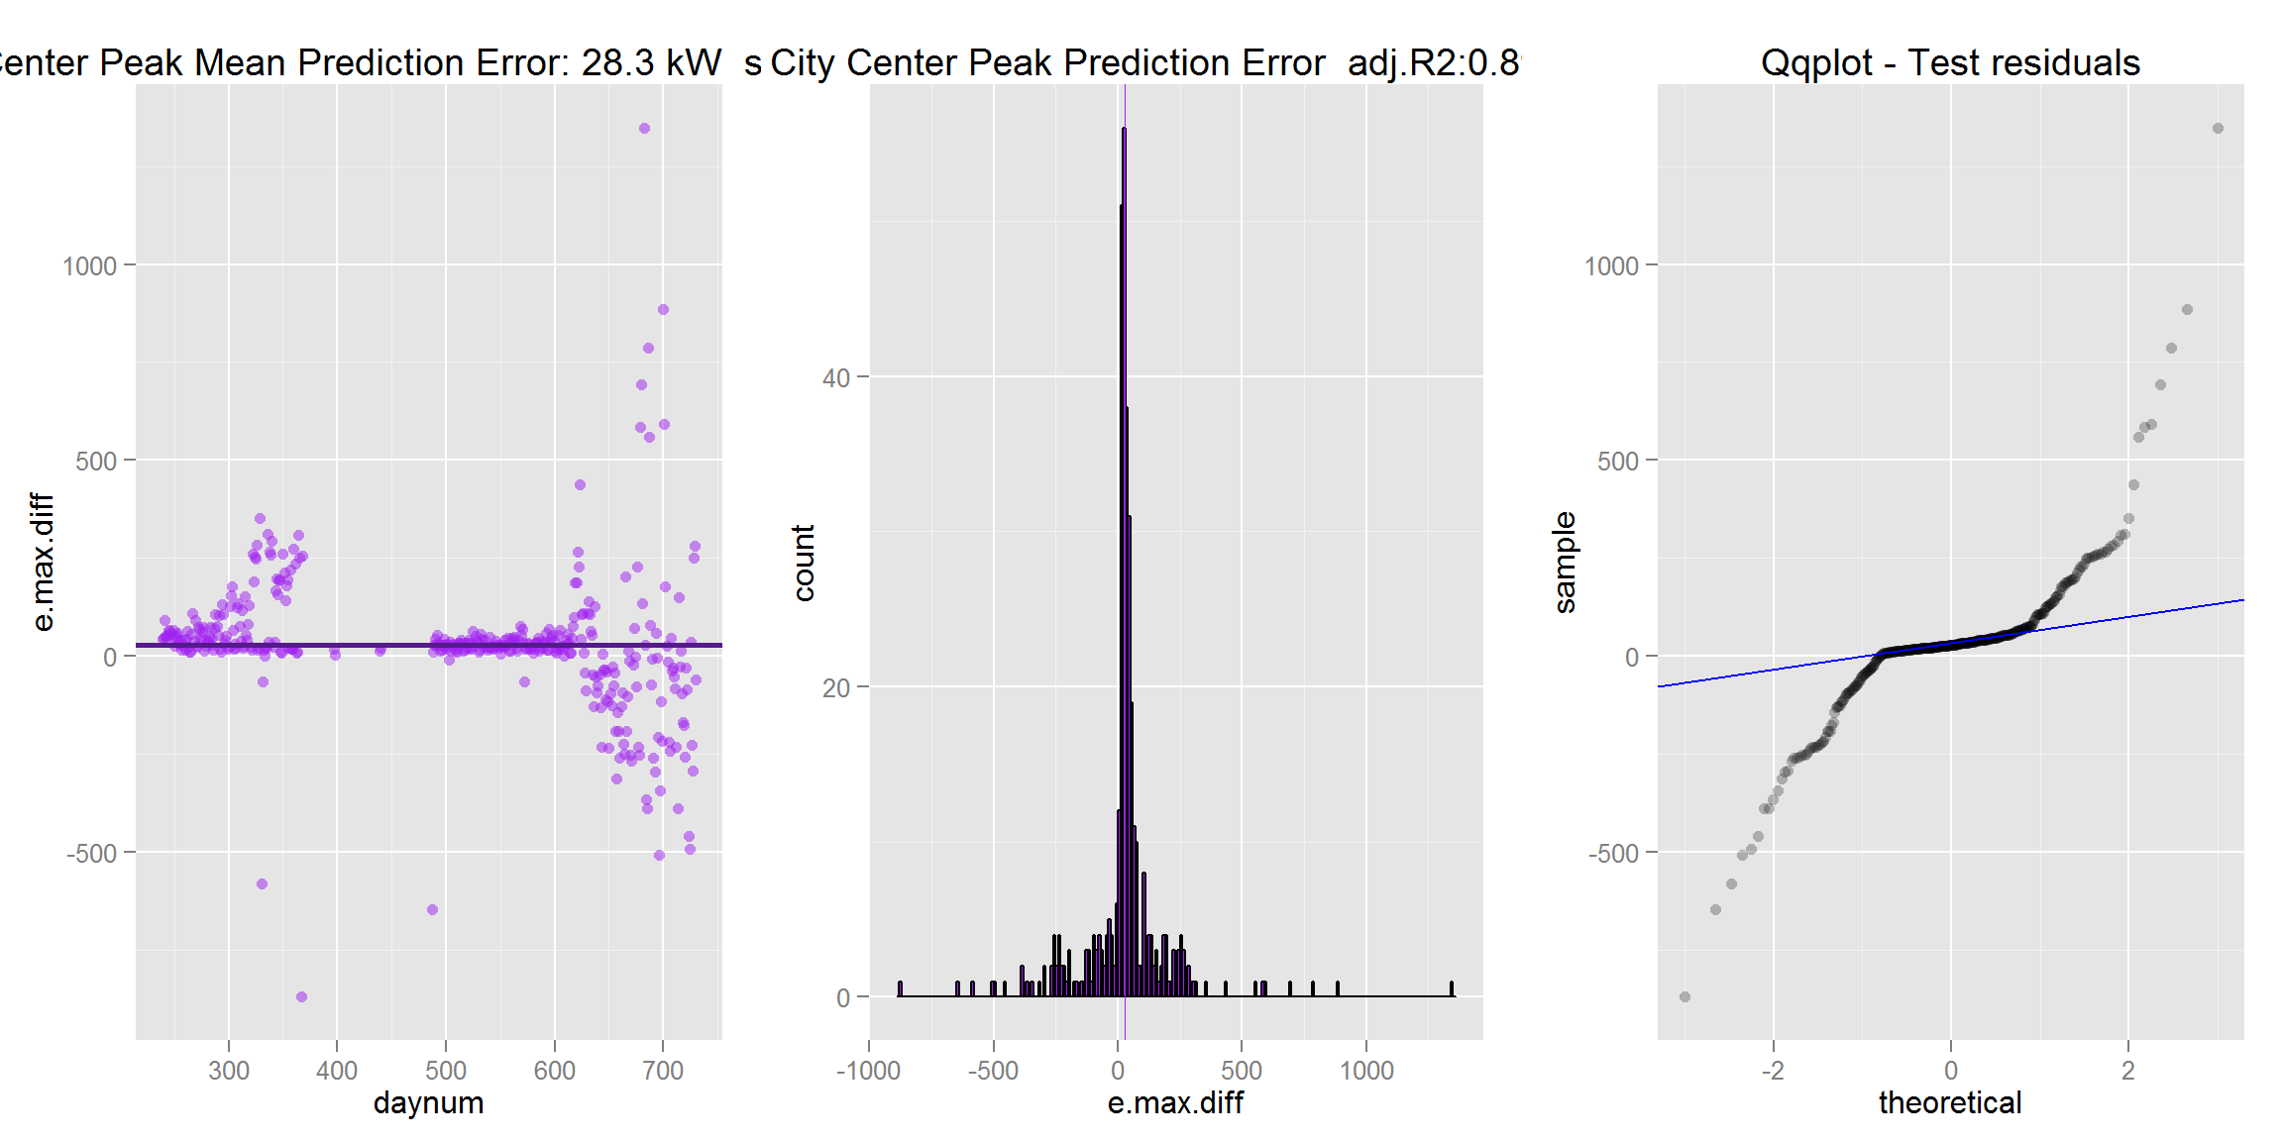
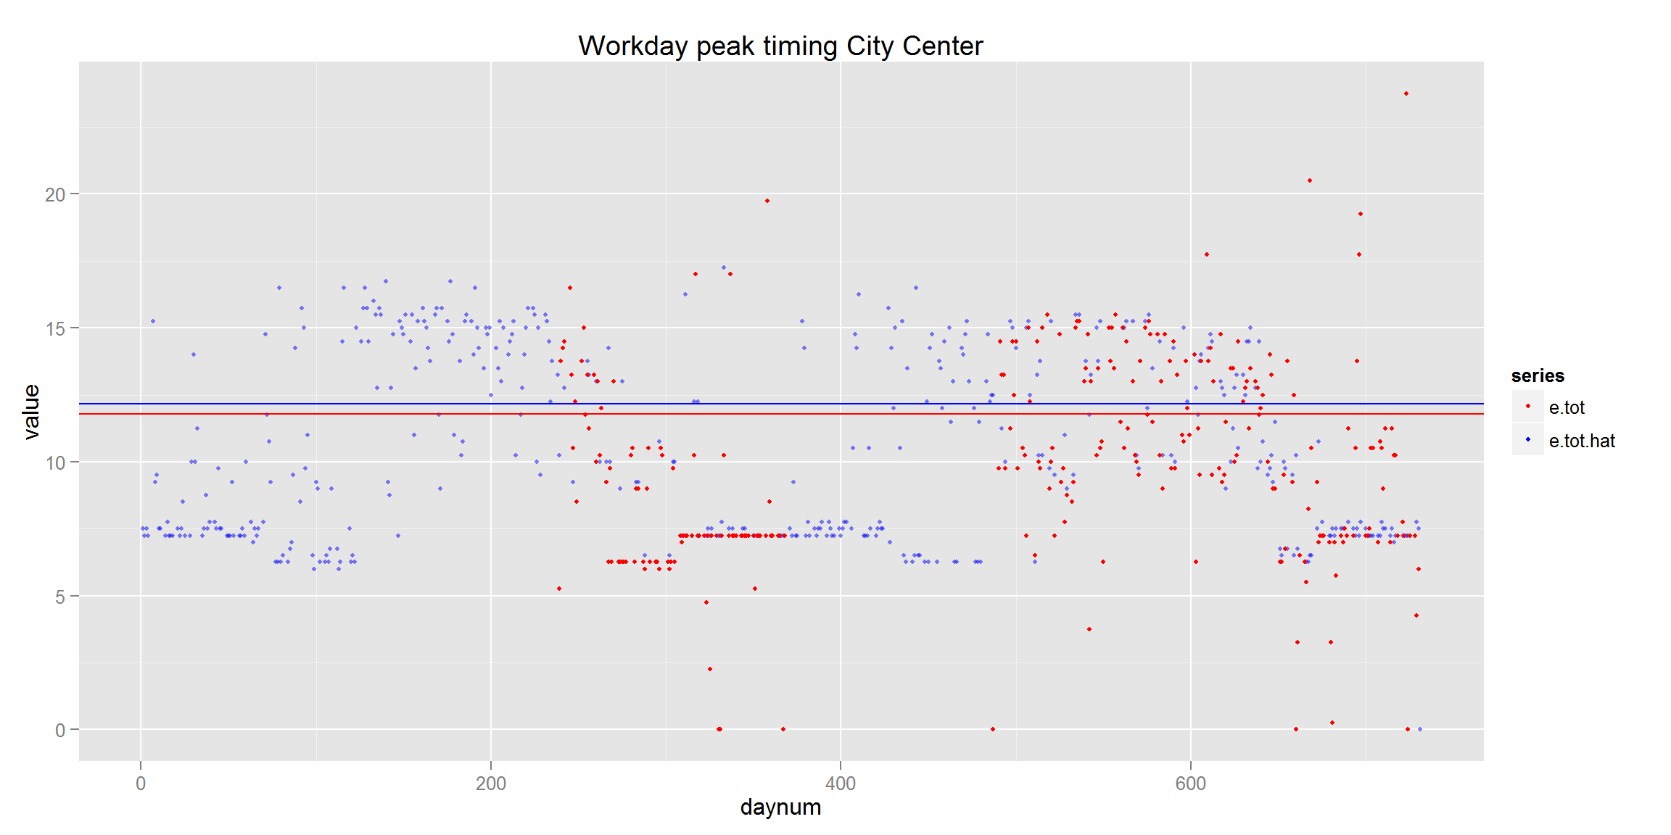
SDB – Modeling – Results (City Center)

Slide 30
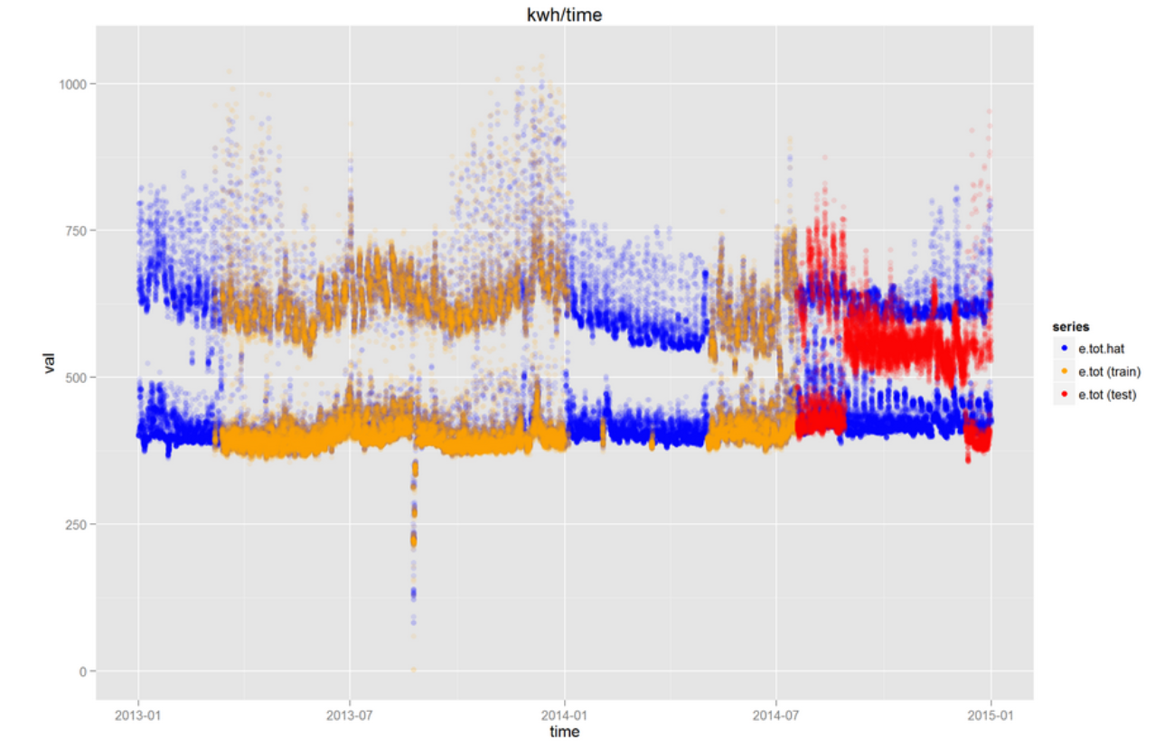
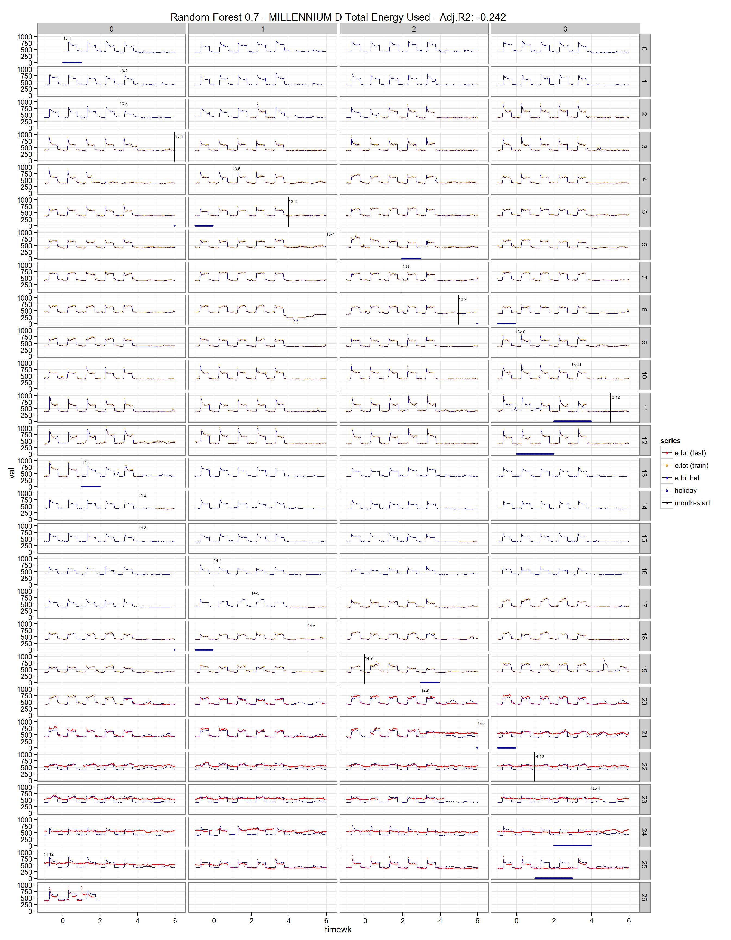
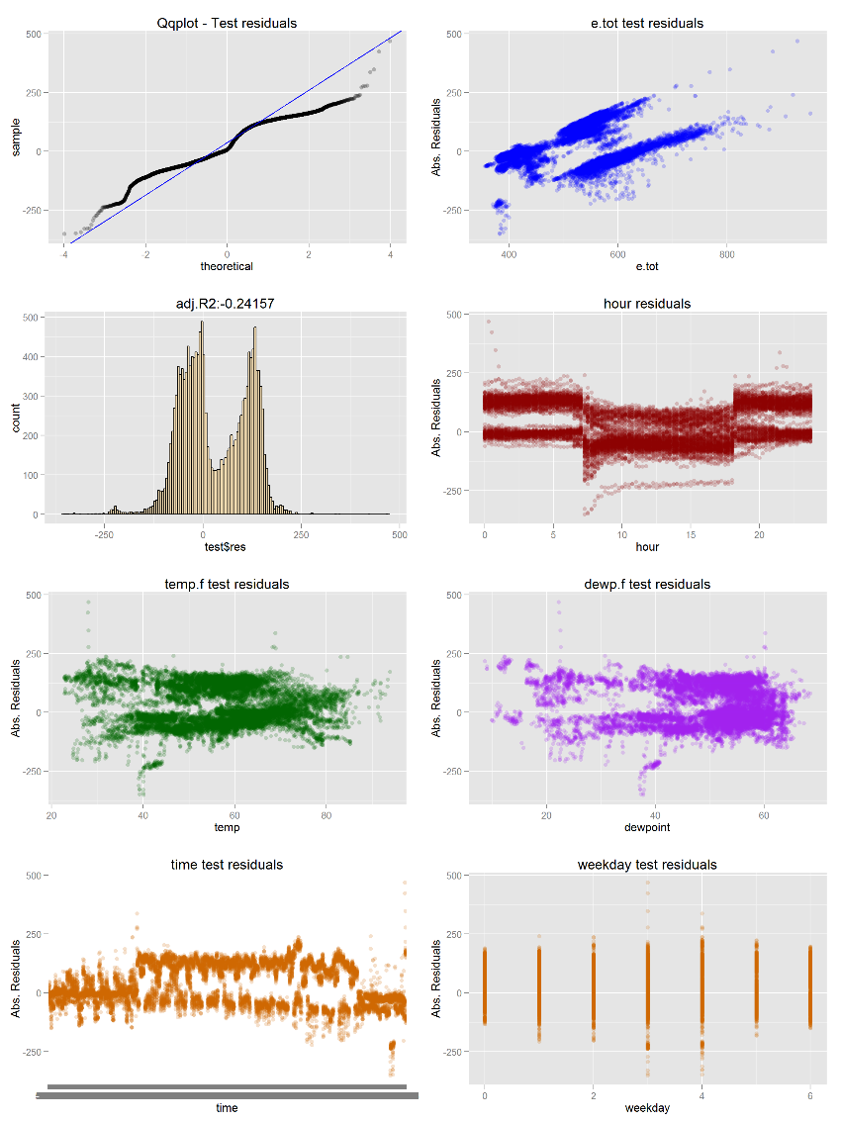
SDB – Modeling – Results (Millenium D)

Slide 31
SDB Evaluation - Overview
Evaluated results by setting up web service, running a simulation, and retrieved values
AML Boosted Tree performed best of methods tried, but this is ongoing

Slide 32
SDB Evaluation - Architecture

Slide 33
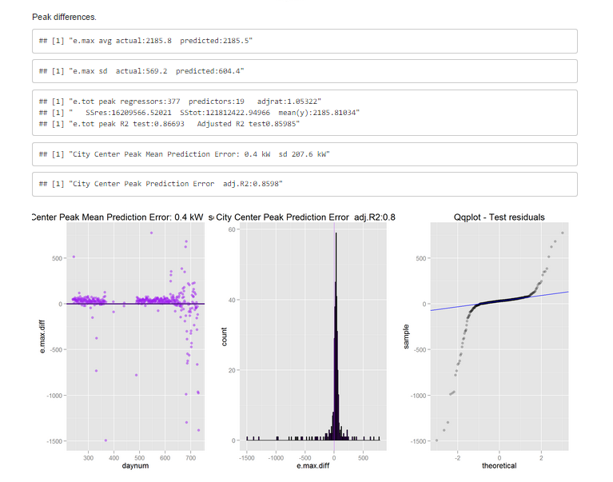
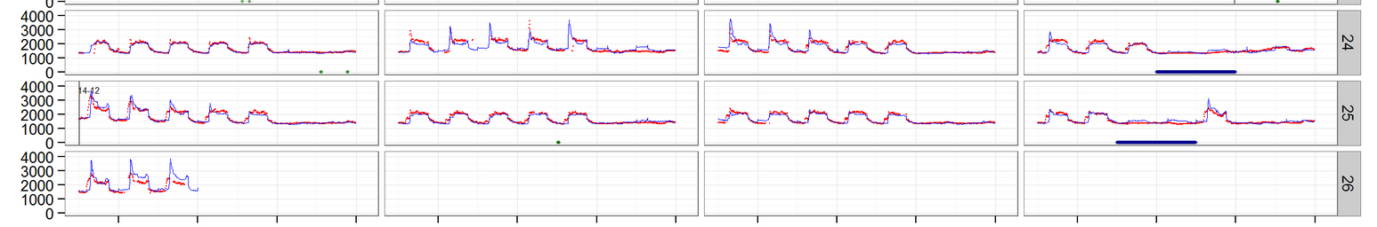
SDB – Evaluation- Results

Slide 34
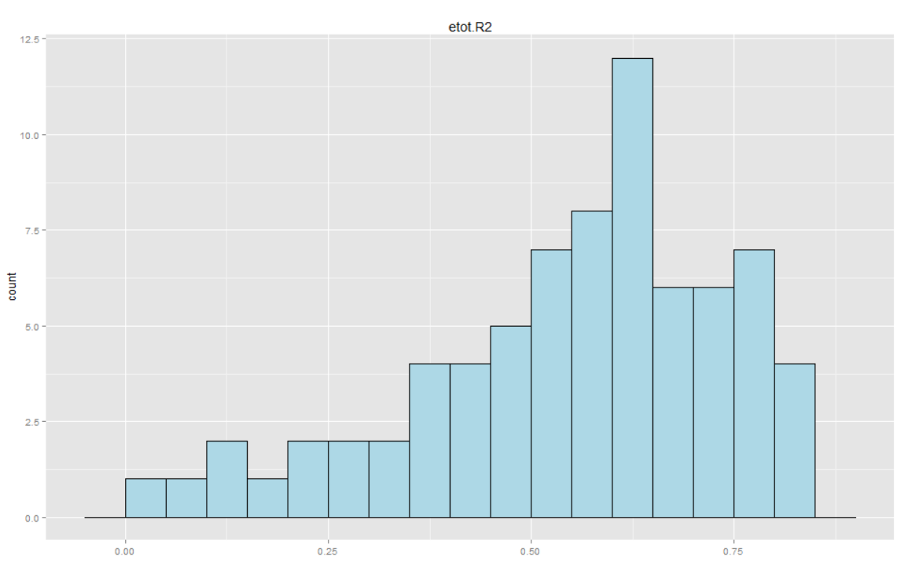
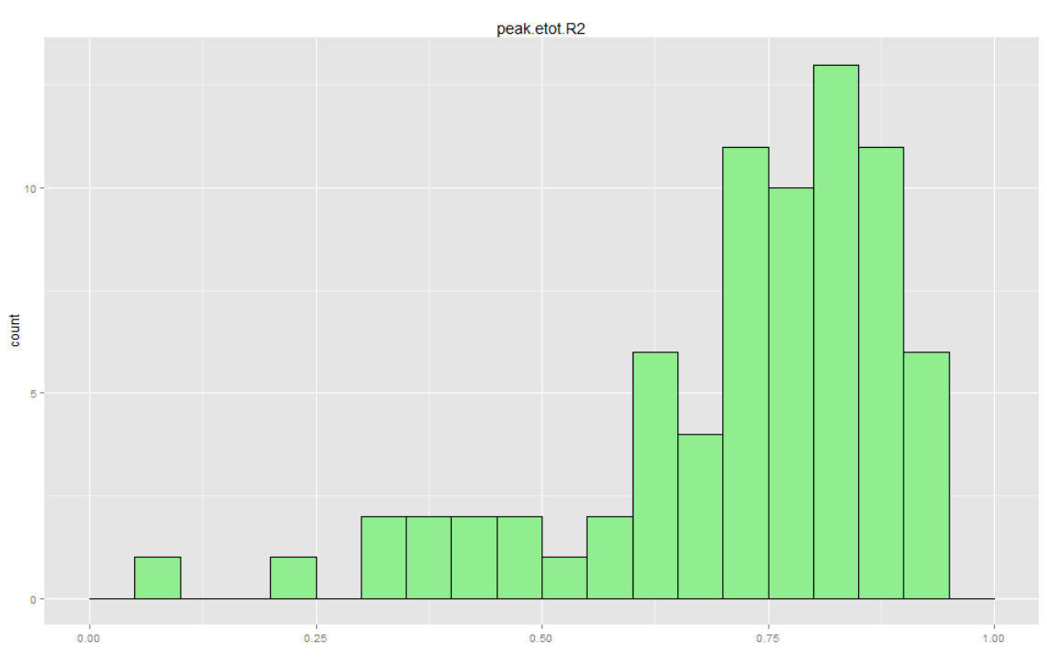
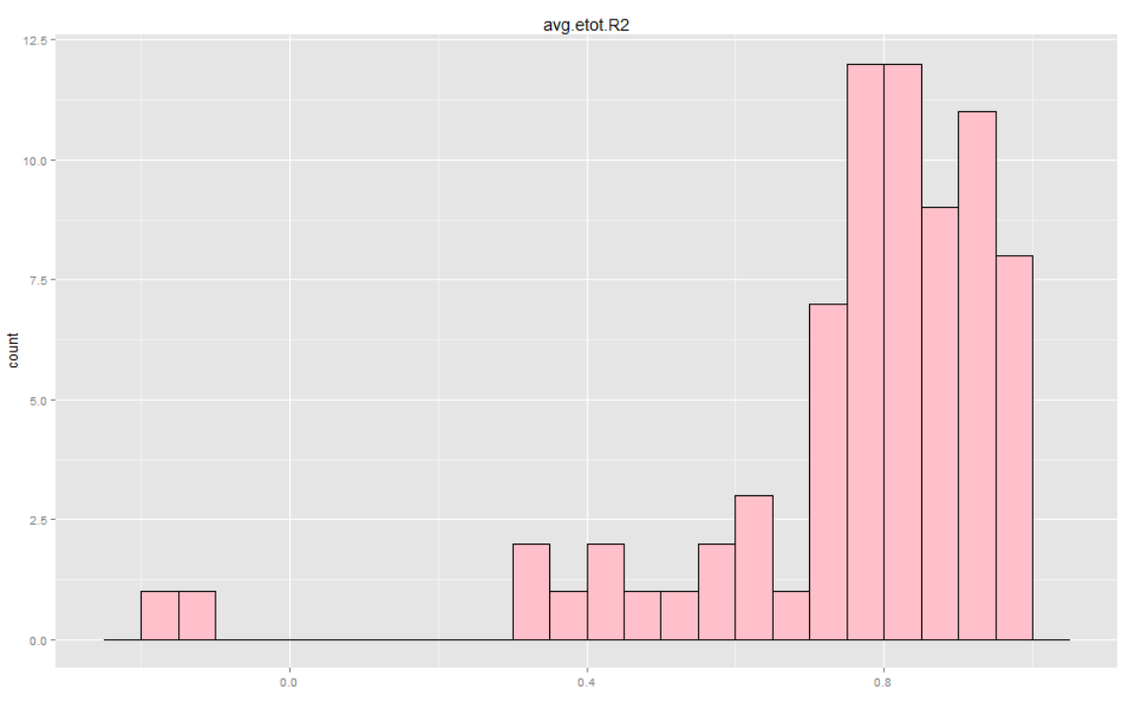
SDB – Modeling – Results – all buildings compared
All 109 buildings, R2<0 eliminated
92 buildings left
Top (blue) is etot.R2
Middle (green) is peak.etot.R2
Bottom (pink) is avg.etot.R2

Slide 35
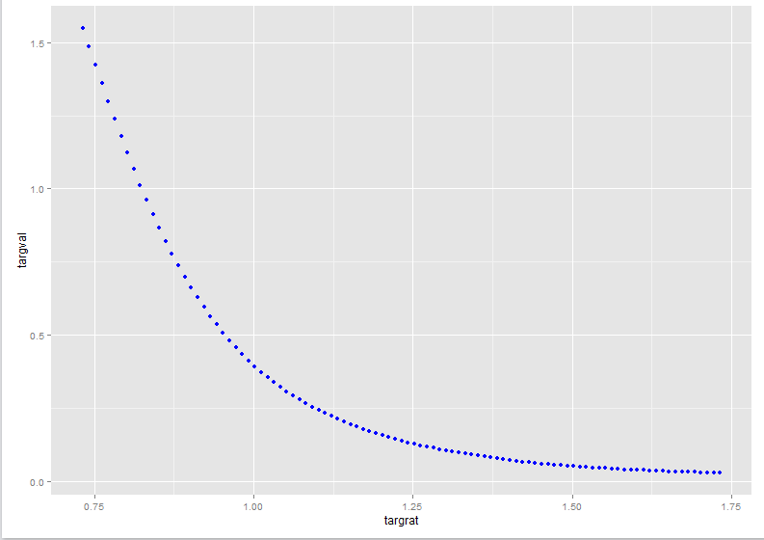
SDB – Evaluation- Results

Slide 36
SDB Deployment - Overview
Weather Forecasts must be integrated
Needs rational reproducible architecture
Pilot needed to show if returns can actually be realized

Slide 37
SDB Deployment - Architecture

Slide 38
88 Acres – Deployment Target Architecture
Smart Building Energy Console
ENERGY
Actuals
Forecast
WEATHER
ºF
Drop By (Bert’s App)
Graph-related API’s
Weather API’s
Energy API’s
Fault API’s
Location API’s
Power BI
Smart Building Platform Services
Weather APP
Cache + Historical & Forecast
Energy APP (ML)
Cache + Historical & Forecast
Fault APP (ML)
Cache + Historical & Forecast
Azure Machine Learning
Building
Fault Models
Building
Fault Models
SQL/SQL Azure
Azure Data Lake
R/O
Copy
STREAM
STREAM
Enterprise Data Directory
Buildings
Weather
Energy
Faults
Azure IoT/Event Hub/Service Bus
Building
Energy Models
Building
Energy Models
Iconics
Other

Slide 39
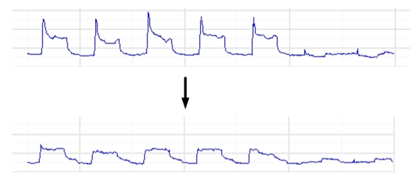
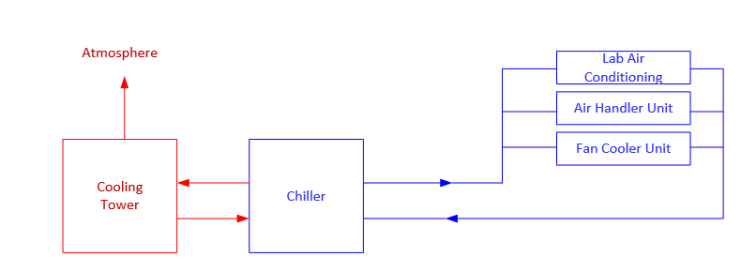
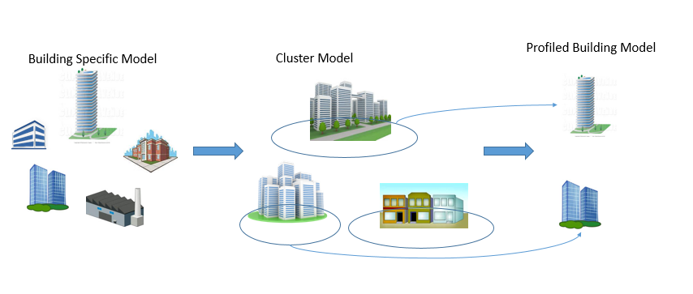
Current Work
Smart Building Energy Console
ENERGY
Actuals
Deploy current AML models into 88 acres production Dashboard
Add control variables to predictive model for peak mitigation
Predictive Maintenance work on Chillers (most expensive and critical piece of an HVAC system)
Create an aggregate clustered building model
Forecast
WEATHER
ºF
Notes:
In the future for energy prediction we are looking at a few things, listed above in the order we are attacking.
One is an aggregated cluster model that will allow us to do a few things
1 – Evaluate the relative efficiency of a building in relation to similar buildings
2 – Start out making predictions for a building before we gather data
3 – Make overall energy usage predications for a general group of buildings without actually having data for those buildings.

Slide 40
Next Steps
Design/ Document/Deploy Pilot
Obtain more data (2015 H1 data)
Add control variables to model and re-train
Investigate automated model creation for AML
Design feasible AML pipeline for 88 Acres Engineers

